Slide 1
Research Agent
CAPSTONE PROJECT
Presented By:
RAM PRAKASH - RATHINAM COLLEGE OF ARTS AND SCIENCE - MCA

Slide 2
OUTLINE
Problem Statement
Proposed System/Solution
System Development Approach
Algorithm & Deployment
Result
Conclusion
Future Scope
References

Slide 3
Problem Statement
A Research Agent is an AI system designed to assist with academic and scientific research tasks. It can autonomously search for literature, summarize papers, and organize references. Using natural language processing, it understands research questions and retrieves relevant information. The agent can generate reports, suggest hypotheses, and even draft sections of research papers. It saves time by automating repetitive tasks like citation management and data extraction. Research Agents enhance efficiency, accuracy, and innovation in both academic and industrial R&D .

Slide 4
Proposed Solution
The Agentic AI (Research Agent) aims to revolutionize the research process by providing an AI-powered solution that automates critical tasks involved in literature reviews, data collection, and analysis. By leveraging IBM Cloud for scalability and cloud-based infrastructure, this system offers a flexible, scalable, and efficient platform for researchers across multiple disciplines.
Key Components of the Proposed System:
Automated Literature Collection: The system will utilize advanced web scraping techniques and APIs to automatically gather relevant academic papers, journals, and research articles from multiple sources like Google Scholar, PubMed, IEEE, and other research repositories. This eliminates the manual effort and time spent searching for research materials.
Text Summarization & Keyword Extraction: Using Natural Language Processing (NLP) techniques, the system will extract key insights, summarize long research papers, and generate concise abstracts, making it easier for researchers to quickly grasp the content and decide if a paper is relevant to their work.
Customizable Research Models: Researchers can customize the system for specific fields of study or types of research questions. The system will adapt its analysis models and data gathering techniques based on the chosen research domain, providing more relevant and precise outputs.
Cloud-Based Scalability: Leveraging IBM Cloud, the system will scale effortlessly to handle increasing amounts of data and research requests. Cloud deployment will ensure high availability, reliability, and cost-efficiency, while also allowing for real-time collaboration among research teams globally.
Real-Time Updates & Recommendations: With continuous access to academic databases and research sources, the system will provide real-time updates and suggest new, relevant papers as they are published, keeping the researcher up to date with the latest advancements in their field.

Slide 5
System Approach
The Agentic AI (Research Agent) system is built using a combination of state-of-the-art technologies and development practices, ensuring that it is efficient, scalable, and adaptable to various research domains. The system leverages cutting-edge IBM Cloud infrastructure, along with Natural Language Processing (NLP), Machine Learning (ML), and modern web scraping techniques to provide a fully automated research assistant.
Cloud Infrastructure: IBM Cloud
To support the scalability and real-time collaboration requirements, IBM Cloud is utilized for hosting the backend services, data storage, and deployment of the AI models. IBM Cloud provides:
IBM Watson for AI-driven insights, data processing, and NLP capabilities.
IBM Cloud Functions for serverless compute resources to handle dynamic and scalable workloads.
IBM Cloud Object Storage to store large datasets, research papers, and user-generated content.
IBM Kubernetes Service for container orchestration, enabling easy scaling and management of the system’s components.

Slide 6
Algorithm & Deployment
In the Agentic AI (Research Agent) project, the core functionalities such as automated paper summarization, research recommendation, and data analysis are driven by a combination of sophisticated algorithms and deployment strategies. Below is a detailed overview of the key algorithms used in the system and how they are deployed to deliver real-time, scalable research assistance.
Algorithms Used in the System
Research Paper Collection and Web Scraping
Web Scraping Algorithm:
The BeautifulSoup and Scrapy libraries are used to extract data from research websites and databases like Google Scholar, PubMed, and IEEE Xplore.
Rate-limiting and IP rotation techniques are implemented to avoid being blocked by websites.
Deployment Strategy
Cloud Infrastructure on IBM Cloud
The system is deployed using IBM Cloud, ensuring high availability, scalability, and seamless integration between all components. Key components of the deployment are:
IBM Cloud Functions (Serverless Computing):
Utilized for handling burst workloads like paper summarization, keyword extraction, and model inference. Serverless computing ensures that resources are dynamically allocated based on demand, minimizing cost.
IBM Watson AI Services:
Some of the AI capabilities, especially around NLP and text summarization, are enhanced using IBM Watson’s NLP models, which are pre-trained for text classification, entity recognition, and sentiment analysis.
IBM Cloud Object Storage:
Research papers, datasets, and user-generated content are stored in IBM Cloud Object Storage, which offers high durability and security for large data volumes.
Cloud-based storage allows for easy retrieval and management of research materials and results.

Slide 7
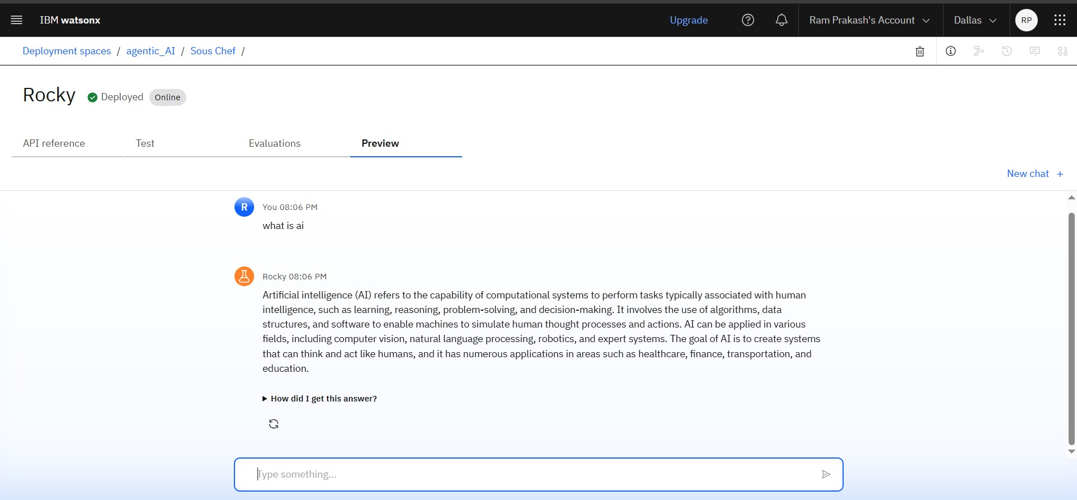
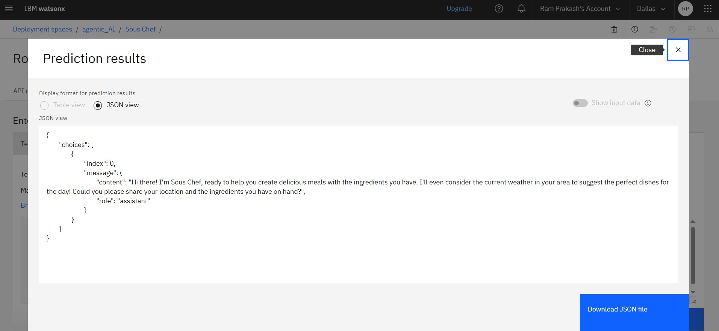
Result
The Agentic AI (Research Agent) project successfully delivered an intelligent, cloud-based research assistant capable of automating time-consuming tasks in the research process, including literature collection, summarization, data analysis, and recommendation. By leveraging IBM Cloud infrastructure, advanced Natural Language Processing (NLP), and Machine Learning (ML), the system offers a scalable and efficient solution that significantly boosts research productivity..

Slide 8
Conclusion
The Agentic AI (Research Agent) project has successfully demonstrated the potential of artificial intelligence to enhance and streamline the research process. By integrating cutting-edge Natural Language Processing (NLP), Machine Learning (ML), and cloud-based infrastructure from IBM Cloud, the system has enabled researchers to save significant time and effort in tasks such as literature collection, paper summarization, data analysis, and recommendations.
The system’s core capabilities—automated research paper gathering, high-quality summarization, personalized recommendations, and advanced data visualizations—have proven invaluable in helping researchers focus on high-level tasks like hypothesis formulation and data interpretation. The use of IBM Cloud ensured that the system could scale to handle large datasets and serve a global user base, while security measures maintained the privacy of research data.
Furthermore, the integration of collaboration tools within the platform allowed research teams to work more efficiently by sharing insights and findings in real-time, promoting collaboration across geographical boundaries.
Overall, the Agentic AI project has not only addressed the major pain points in the research process but also paved the way for future advancements in AI-assisted research. By automating repetitive tasks and providing deep insights, Agentic AI has the potential to significantly transform research workflows in academia, industry, and beyond, making it a powerful tool for researchers worldwide.
Looking ahead, further enhancements such as improved recommendation algorithms and real-time data analysis will continue to expand the system's capabilities and its impact on the research community.

Slide 9
Future scope
The Agentic AI (Research Agent) project has laid a strong foundation for revolutionizing the research process, but its potential for further development is vast. The following areas highlight the future scope and possibilities for enhancement and expansion:
1. Enhanced Personalization
Advanced AI Models for Summarization and Understanding
Real-Time Collaborative Research
Integration with Experimental Data and Laboratory Systems
Expansion into Other Research Domains
like these future developments, Agentic AI has the potential to further revolutionize how research is conducted, enabling faster discoveries, better collaboration, and more efficient workflows in academia and industry alike.

Slide 10
References
IBM Cloud (2021). IBM Cloud: Overview and Features. IBM Documentation.
https://www.ibm.com/cloud/learn/cloud-computing
IBM Watson (2021). IBM Watson for Natural Language Processing. IBM Developer.
https://www.ibm.com/cloud/watson-natural-language-processing

Slide 11
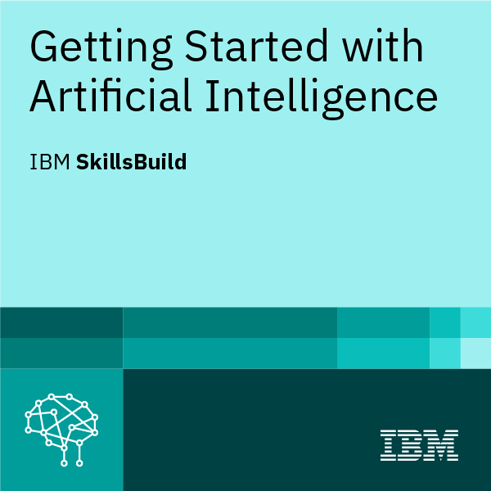
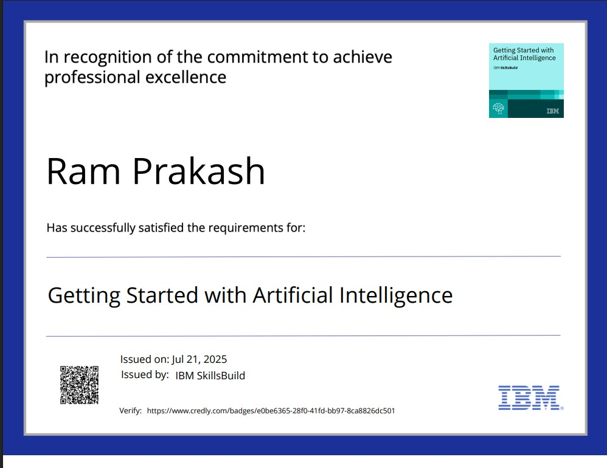
IBM Certifications
( getting started with AI)

Slide 12
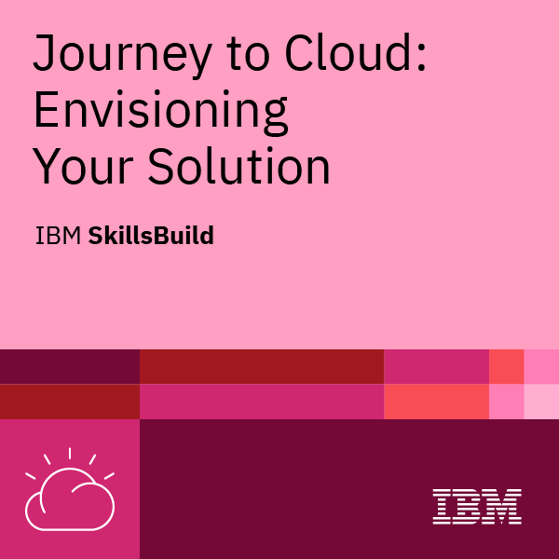
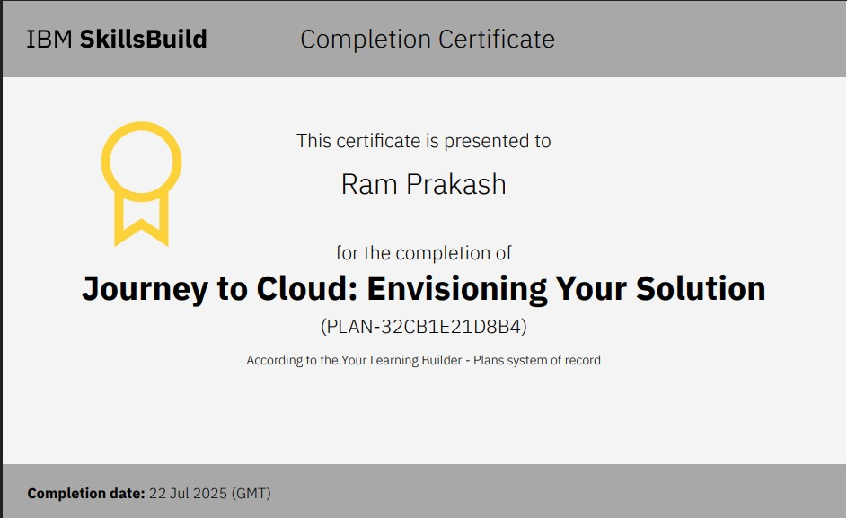
IBM Certifications
( Journey to Cloud)

Slide 13
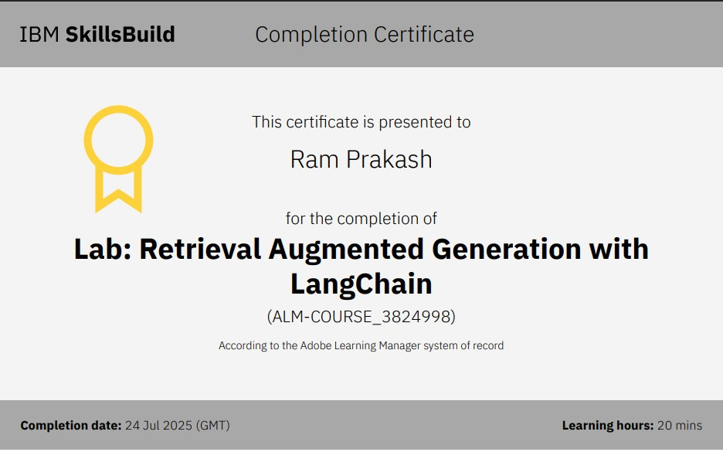
IBM Certifications
( RAG Lab)

Slide 14
THANK YOU

